Slide 1

AI-POWERED
Wildfire Early Detection
Milestone 6
Group 8

Slide 2
Overview & Problem Statement
Introduction
The Challenge
Why Early Detection Matters
01
The Speed of Wildfires
Under high winds and bone-dry air, a single spark can transform into a roaring blaze in minutes.
02
Limited Response Resources
Emergency services operate on finite budgets and cannot patrol every mile of the state simultaneously.
03
Late Incident Notice
Waiting for human calls or satellite smoke detection often means responding too late to prevent catastrophic loss.
The AI-Powered Solution
Proactive Wildfire Early Detection
Our system continuously analyzes weather physics, landscape topography and vegetation dryness to calculate daily wildfire hazard levels across California.
Instead of overwhelming crews with alerts, it identifies the Top 25 Highest-Risk Zones Every Day. This provides organizations like CAL FIRE a crucial one-day head start to preposition resources and protect communities before ignition.

Slide 3

ENVIRONMENTAL PIPELINE
Data Sources
01 Copernicus DEM
Terrain Surface & Slope Acceleration - 30 m (Aggregated to 0.25°)
02 Sentinel 2
Vegetation Health & Moisture Indices - 10–20 m / ~5-day Revisit
03 Sentinel 5P
Atmospheric Composition - 3.5 km × 5.5 km
04 ERA5
Atmospheric & Surface Weather - 0.25° Grid / Daily (5d lag)
05 FIRMS
Ground-Truth Target Fire Labels - 1km / Daily
DATA INGESTION
Google Earth Engine
We have extracted high-resolution environmental data directly from the Google Earth Engine platform, spanning multiple satellite constellations and climate reanalysis streams to power our predictive modeling.

Slide 4
Dataset Specifications
Data Range & Split
CHRONOLOGICAL SPLIT
Temporal Partitioning
2019 - 2022
Training Phase
Base historical data utilized to train the machine learning models. Training is restricted exclusively to May through November, capturing the high-activity months when most wildfires occur.
2023 / 2024
Validation & Calibration
Intermediate years reserved for validation (2023) and calibration (2024).
2025
Out-of-Sample Testing
Strictly separated test partition to evaluate model forecasting capability.
GEOGRAPHY & RESOLUTION
Spatial Parameters
California Focus Analysis is restricted strictly to the California state boundary.
Grid Resolution Using ERA5 atmospheric reanalysis grid cells at 0.25-degree resolution.
Training Zones High and medium hazard fire zones selected specifically for training.

Slide 5

CALIFORNIA SYSTEM
Unified Data Fusion for Predictive Wildfire Modeling
PIPELINE RESOLUTION & COVERAGE
Extensive panel coverage spanning California grid cells at approximately 25 km spatial resolution.
63
RAW FEATURES
4
DATA SOURCES
Our multi-modal pipeline integrates 63 raw features from 4 primary streams:
ERA5 Weather: 25 variables
Copernicus DEM: 8 terrain features
Sentinel-2 Optical: 21 spectral bands
Sentinel-5P Gas: 10 atmospheric cols
2,557
PANEL DAYS
672
GRID CELLS
DATA CHALLENGE
Missing data
Class Imbalance
Resolution differences

Slide 6


Data Preprocessing & Cleaning Pipeline
RAW INPUT: 63 COLUMNS ACROSS 672 GRID CELLS
STEP 01
Data Cleaning
Ensures baseline data integrity by performing critical sanitation operations:
Drops constant/redundant columns.
Clips soil moisture values based on physical and atmospheric constraints.
STEP 02
KNN Imputation
Resolves observational gaps using Spatial-Temporal K-Nearest Neighbors:
Addresses Sentinel-2 optical cloud cover and orbital gaps.
Leverages spatial autocorrelation to reconstruct missing indices without zero/median bias. Backed by Literature: Liu et al., Remote Sensing 2020 (MDPI Article 1884)
STEP 03
Risk Stratification
Focuses modeling efforts on highly vulnerable, active fire zones:
Filters study domain down to High/Medium risk classes(data source).
Reduces grid footprint from 672 original cells to 437 .

Slide 7
Feature Engineering & Pruning Pipeline
FEATURE CONTRACT: 107 CANDIDATES → 86 PRODUCTION
STEP 04
Feature Engineering & Causality
Temporal causality contracts applied with minimum 2-day lags to prevent lookahead bias:
FIRMS neighboring cells & historical cells
ERA5 14-day & 30-day meteorological rollups
Sentinel 2 - 5-day observation window
107 2d
Candidate Features Temporal Lag Contract
STEP 05
TreeSHAP Feature Pruning
Identifies and eliminates lowest contribution variables to secure a highly refined:
20% 86
Features Pruned Active Production
Features
Minimizes multicollinearity and resource usage while preserving predictive performance.

Slide 8
Why LightGBM as Champion Algorithm?
CORE TECHNICAL ADVANTAGES
• Efficiency on Grids: Faster training speed and lower memory footprint on high-dimensional multi-sensor grids.
• Data Robustness: Native handling of continuous satellite features and sparse missing values without complex imputation.
BACKED BY LITERATURE
MDPI Remote Sensing (2022) proved LightGBM outperforms Random Forest and Logistic Regression.
0.935 88.8%
ROC-AUC Accuracy
"A Forest Fire Susceptibility Modeling Approach Based on Light Gradient Boosting Machine Algorithm"
Read Published Research Paper →
WHY OUR ROADMAP OUTPERFORMS THE LITERATURE
A. 50/50 Balance vs. Real-World Class Imbalance
The Paper: Trained on an artificial 50/50 split (inflates metrics).
Our Model: Entire state of CA under realistic <1.5% fire imbalance.
B. Static Susceptibility vs. Dynamic 24h Forecasting
The Paper: Static spatial likelihood mapping of a single regional park.
Our Model: Next-day dynamic temporal forecasting for proactive deployment.
C. Dual-Engine Architecture (Classifier + Ranker)
The Paper: Basic single-head standard classification.
Our Model: Dual-Head Classifier + LambdaRank with calibrated output.

Slide 9

Champion Model Pipeline & Alert Inference
86 Features
(cell-day)
HEAD 1
LGBM Classifier
binary
Platt Calibrator
(2024 only)
Classifier Percentile
calibrated
0.3 / 0.7 Blend
alert_score
Daily Top-25
Alerts
HEAD 2
LGBM Ranker
lambdarank
Ranker Percentile
within-day

Slide 10
Model Evaluation • Headline 2025 Test Results
Champion Model Performance
ROC-AUC
0.77
Separates fire vs no-fire well above chance
Key Strategic Insight
Optimal Ranking & Alerting Tool
This model is highly effective when used as a prioritized daily ranking system, but is not designed to act as a simple "fire/no-fire" binary switch.
PR-AUC
0.145
Decent under rare events (~1.4% fire rate)
Recall@25
36%
Catches ~1 in 3 real fires if you alert top 25 cells/day
Precision@25
9%
~1 in 11 top-25 alerts is a true fire
False Alerts/Day
~23
Cost of that daily recall budget

Slide 11
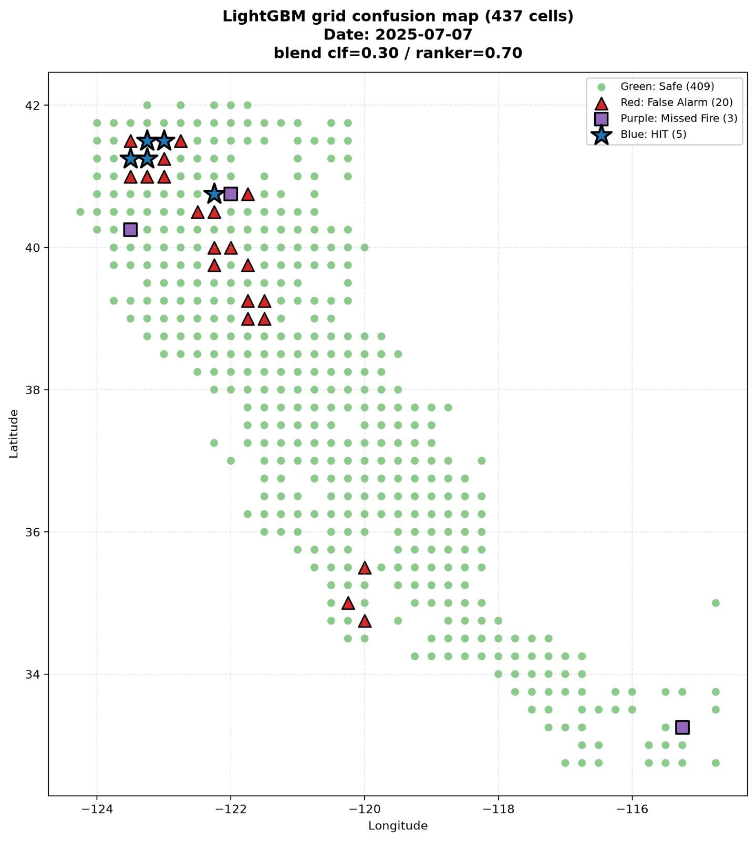
Champion Model Output
This is the output for July 7th 2025
TP: 5
TN: 409
FP: 20
FN: 3
This captured 5 out of 8 fires which is 62.5% of all fires on that day.

Slide 12
Model Interpretation • Survey Alignment
Interpreting Champion Results In Context
01 • LOW PROBABILITIES
Rarity Drives Low Scores
With a 1.42% prevalence, even our high-performing multimodal model (ERA5, S2/5P, DEM) correctly assigns near-zero risk to most grids.
02 • OBJECTIVE-DEPENDENT
Built for Top-K Ranking
A strict 0.5 cutoff is virtually useless here. The system is optimized as a Top-25 daily alerting tool such that recall is significantly improved.
03 • BASELINE COMPARISON
~15x Over Chance
Absolute scores look modest but our PR-AUC 0.145 vastly outperforms chance (0.009), persistence (0.041), and weather-only (0.096).
04 • TEMPORAL SHIFT
Unresolved Transferability
The 2023 to 2025 performance drop reflects honest future-held-out testing, revealing true real-world deployment challenges.
05 • GEOGRAPHIC ERROR
Physical, Non-Random Bias
Over-prediction concentrates in northern CA & misses follow Sierra terrain, showing error patterns are strictly shaped by seasonal regimes.
SUMMARY INSIGHT
Strong & Viable Tool
Our metrics define a highly useful daily ranking system that regionalizes risk, where moderate precision is the expected cost of catching rare fires.

Slide 13
Champion vs Other Models
MILESTONE 3
Multimodal Fusion
Accuracy:81.50%
PR-AUC:0.531
ROC-AUC:0.831
Recall:76.20%
Evaluated on 4:1 sampled sub-dataset; S2 CNN + S5P CNN + ERA5/DEM LSTM
MILESTONE 4
V4 LightGBM
Accuracy:98.24%
PR-AUC:0.1751
ROC-AUC:0.842
Recall@25:38.33%
Full grid evaluation; optimized directly for daily alert budget (Recall@25) - Test for 2025
MILESTONE 5
LightGBM Champion
Accuracy: 98.54%
PR-AUC: 0.1451
ROC-AUC: 0.7718
Recall@25: 36.38%
Stage C KNN pre-imputation, May-Nov fire season, high/med fire cells - Test for 2025

Slide 14
Deployment
STEP 01cloud_download
Data Ingestion
Previous day data is downloaded to GCS Bucket from GEE.
STEP 02layers
Preprocessing
It is processed into parquet files, joined together and stored in GCS Bucket after preprocessing.
STEP 03schedule
Orchestration
A cron job is run everyday from Cloud Run to do the above two steps.
STEP 04dns
Hosting
The frontend and backend are hosted in the GCP instance with a predict endpoint.
STEP 05visibility
Default View
By default the application shows next day’s fire prediction to the user.

Slide 15
DEMO

Slide 16
References
A Forest Fire Susceptibility Modeling Approach Based on Light Gradient Boosting Machine Algorithm
A Comprehensive Survey of Satellite-Based Wildfire Indicators and Spatiotemporal Modeling Approaches: Past, Present, and Future
EGUsphere - Direct Estimation of Wildfire Emissions at High Latitudes from Combined Polar Orbiter FRP and Sentinel-5P CO Data

Slide 17
Signatures
Name | Roll Number | Signature
Ripunjay Kumar | 21F3002511 | ✅
Lakshay Garg | 21F3001076 | ✅
Roushan Kumar Singh | 23F1002240 | ✅
Lakshmi Sruthi K | 21F1005626 | ✅
R Aditya | 21F1004839 | ✅

